Slide 1
Initial study
Vision
视力
Please study the English term based on the translation & the picture
Press K if you know the English term

Slide 2
Training: Word-Translation
Macerate
Please type the corresponding translation

Slide 3
Training: Word-Translation
浸泡
Please type the corresponding English term

Slide 4
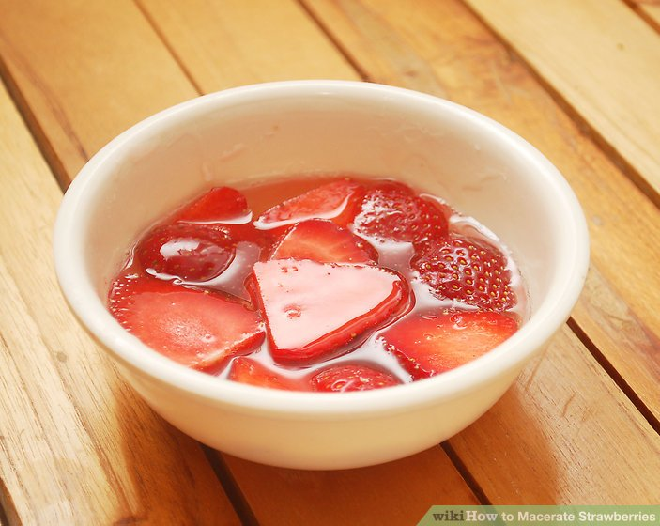
Training: Picture + translation-word
浸泡
Please type the corresponding English term

Slide 5
Training: Restudy
Macerate
浸泡
Please study the word pair carefully

Slide 6
Posttest: Translation-word
Please type the corresponding term
视力
Vision

Slide 7
Training: Word-Translation
Please type the corresponding translation
Vision
视力

